Slide 1
Top 5 Places to Work
Melissa Nooney

Slide 2
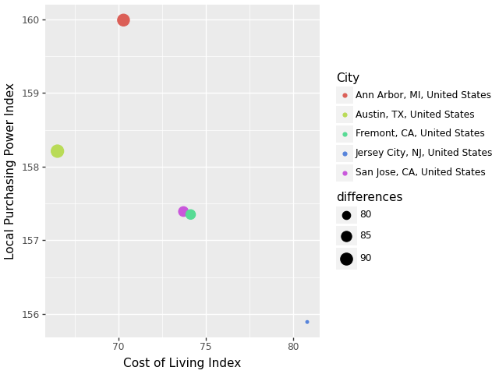
On-Site Work Locations
Best Locations to live and work:
Austin, TX $146k median
Google, Apple, Facebook
Ann Arbor, MI $164k median
Cisco, MITRE, XPO Logistics
San Jose, CA $205k median
Adobe, Microsoft
Fremont, CA $210k median
Facebook, Tesla
Jersey City, NJ $186k median
Garmin, Goldman Sachs, Fidelity
National Median: $140k

Slide 3
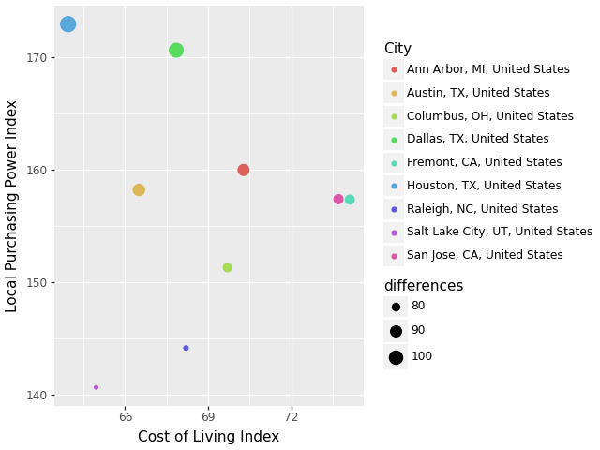
Hybrid Work Locations
Best Locations to live and work:
Houston, TX $120k median
Exxon, Schlumberger
Dallas, TX $115k median
Intuit, Amazon, Walmart
Austin, TX $146k median
Google, Apple, Facebook
Ann Arbor, MI $164k median
Cisco, MITRE, XPO Logistics
San Jose, CA $205k median
Adobe, Microsoft
National Median: $117.5k

Slide 4
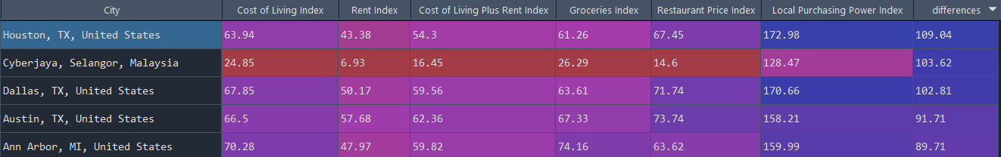
Remote Work Locations
Best overall locations to live while working remotely:
Best company locations to work remotely:
Kirkland, WA $505k median
Google
Los Gatos, CA $420k median
Netflix
Oakland, CA $350k median
Microsoft, Pandora
Berkeley, CA $277 median
Microsoft, Bayer
Boulder, CO $265k median
Twitter, Workday
National Median: $140.4k

Slide 5
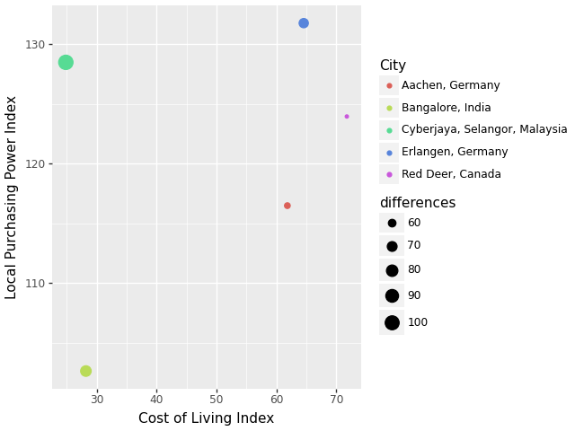
Top 5 International places to live while working remote

